Slide 1

QED-TD-DFT: Photon Quantization for Strong EM Coupling Modelling
Vaibhav Vaiyakarnam
Chemistry 221B, Spring 2026

Slide 2
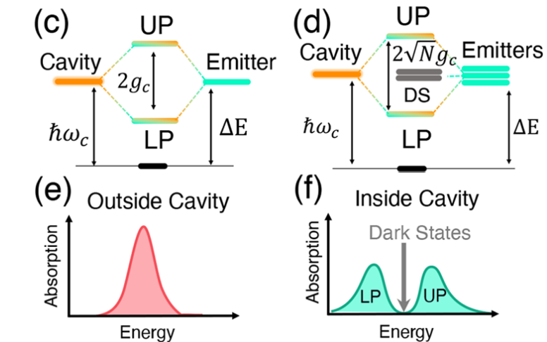
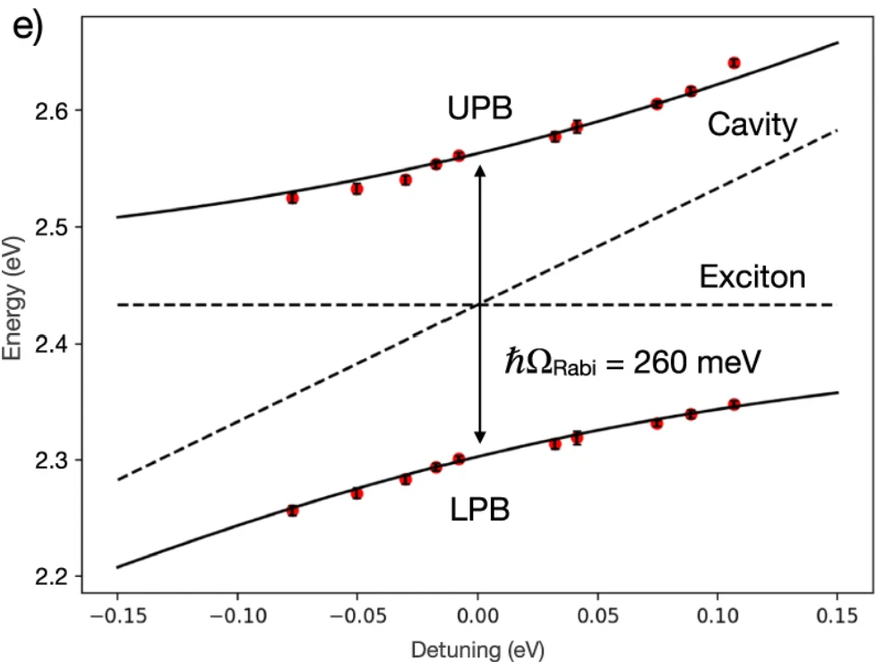
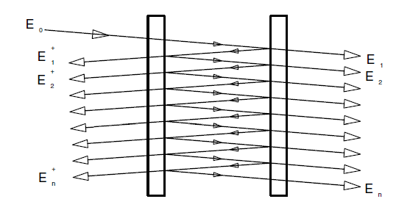
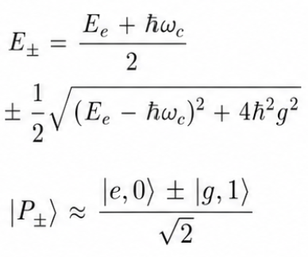
Motivation: Exciton-Photon Polariton Coupling
Mandal, A., et al Chemical Reviews 123 (16), 9786-9879 (2023).
https://doi.org/10.1021/acs.chemrev.2c00855
Laitz, M., et al. Nat Commun 14, 2426 (2023). https://doi.org/10.1038/s41467-023-37772-7
Weak-field: Light absorbed by molecule and emitted, can be treated classically and separate from the electron
Strong-field: Light, as photons, hybridizes its energies with that of the molecule
Leads to long, large-scale coupling across macroscopic distances between molecules in an ‘optical cavity’
Interference between resonant photon cavity modes and exciton frequency causes splitting of energy states into polaritons

Slide 3
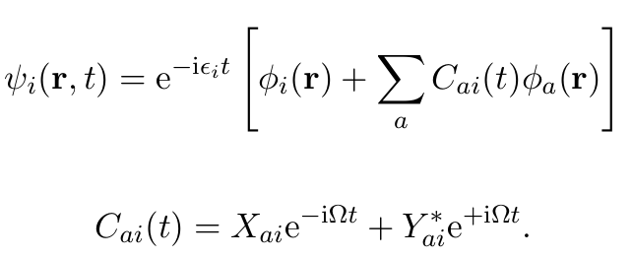

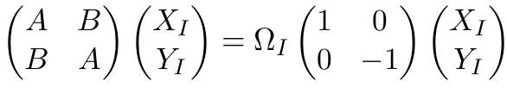
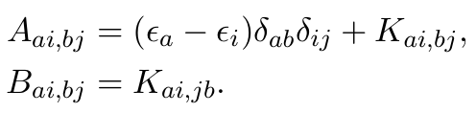
Review – TD-DFT and Casida Formulation
Linear response of inexact wavefunction/density when in a weak field
Tamm-Dancoff Approximation (TDA):
No deexcitations – Y = 0.
Simplification of TD-DFT
Generally, all right if a process only requires the behavior of two major states
Not that high of an error when compared to normal TD-DFT for non-pathological molecules

Slide 4
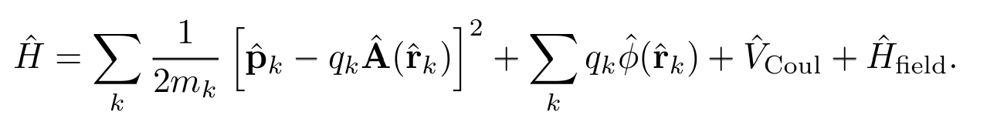

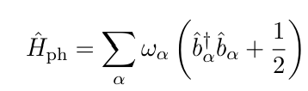
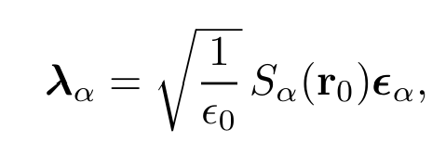
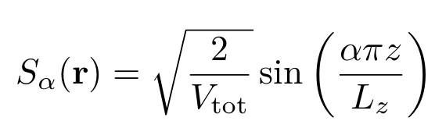
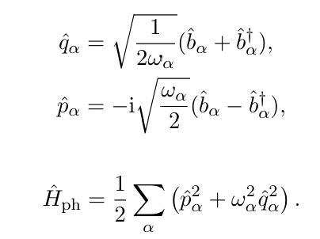
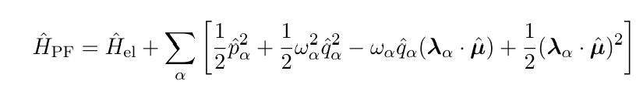
Pauli-Fierz Hamiltonian – Quantizing Photons
Total Hamiltonian = molecular Hamiltonian + the EM field Hamiltonian + interaction terms that arise from “covariant derivatives” that couple electrons to EM to preserve gauge invariance
(as seen in class and hinted at in HW)
Weak field – leave the light as a classical wave
Strong field – Light is composed of photons of different modes – quantize A

Slide 5

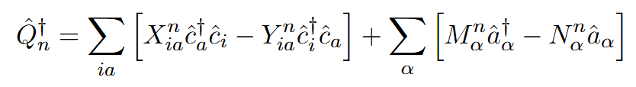
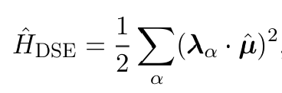
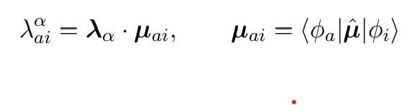
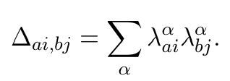
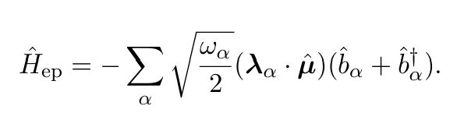
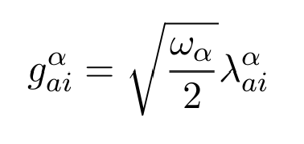
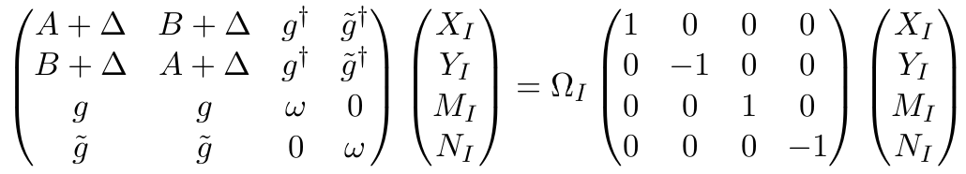
QED-TD-DFT as linear response with quantized photons
Polariton states now represented in the joint Hilbert (Fock) space of the electrons and the photons
1.
2.

Slide 6
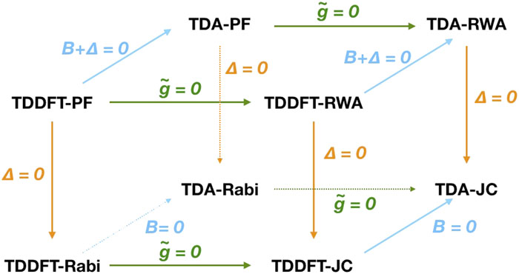
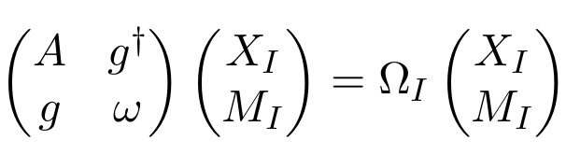
Approximations to QED-TD-DFT
Varied assortment of approximations exist for QED-TD-DFT
For ease, I have used TDA-JC:
B = 0: No electronic deexcitations, as in the case of standard TDA (i.e., stable, large-frequency excitations)
g̃ = 0: No ‘counterrotation’ coupling – Only well-defined, single-photon processes can be modelled (which is what we care about)
Δ = 0: DSE term is small when g/ω<<1 (which it is in the calculations here)
Molecule only interacts with one major wavelength in the cavity
Yang, J., et al. Chem. Phys. 155 (6), 064107 (2021). https://doi.org/10.1063/5.0057542
Notes:
MARK WHAT APPROXIMATIONS I AM USING

Slide 7
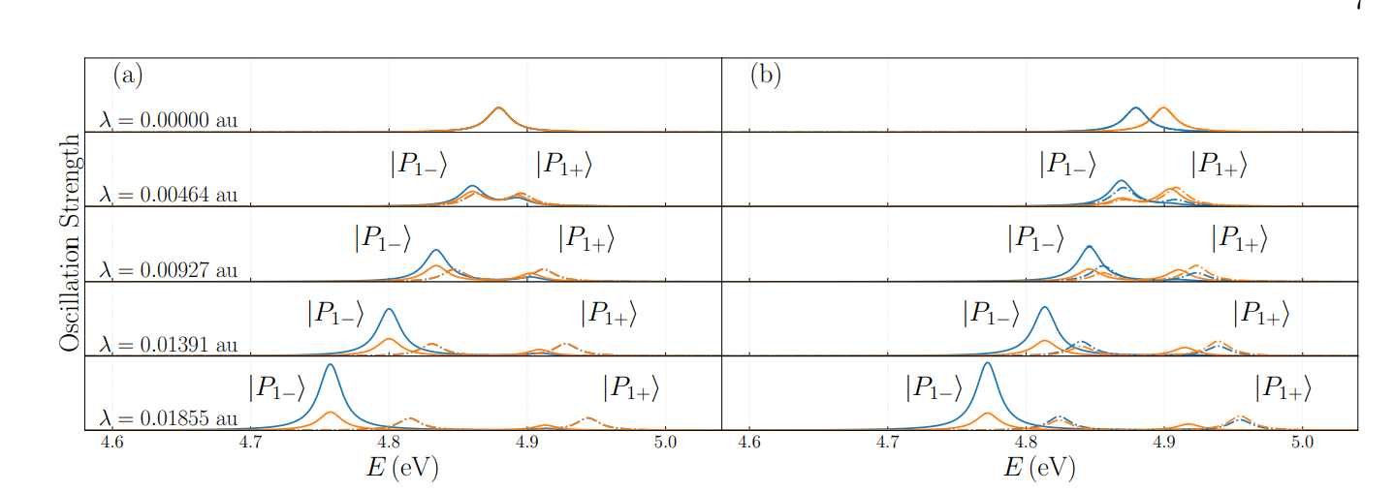
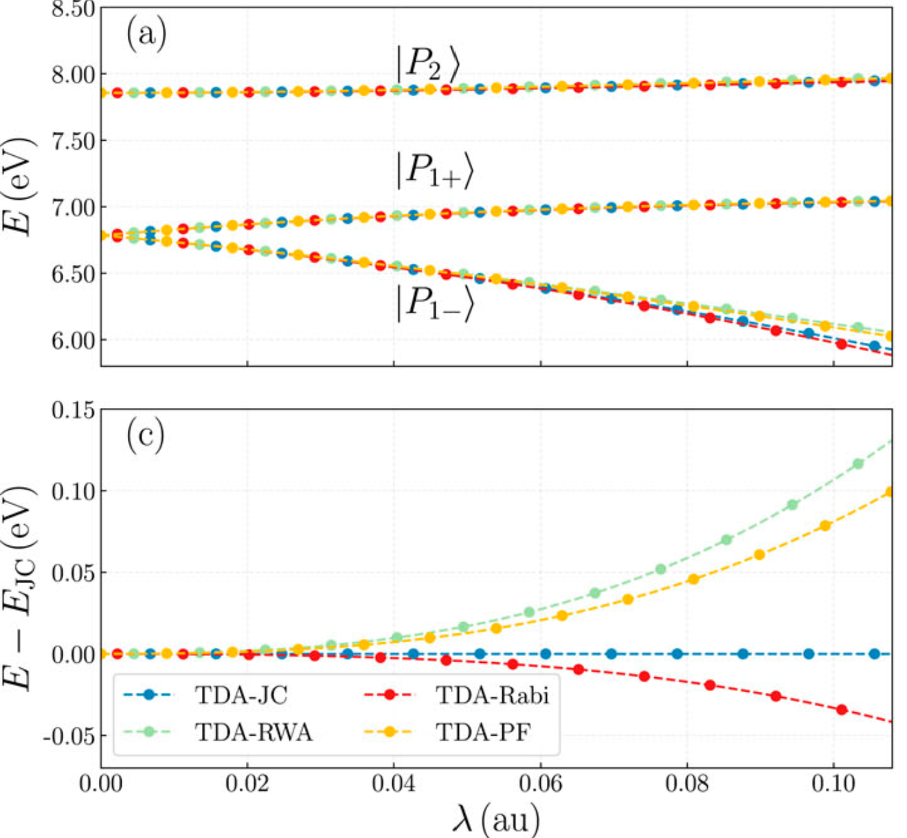
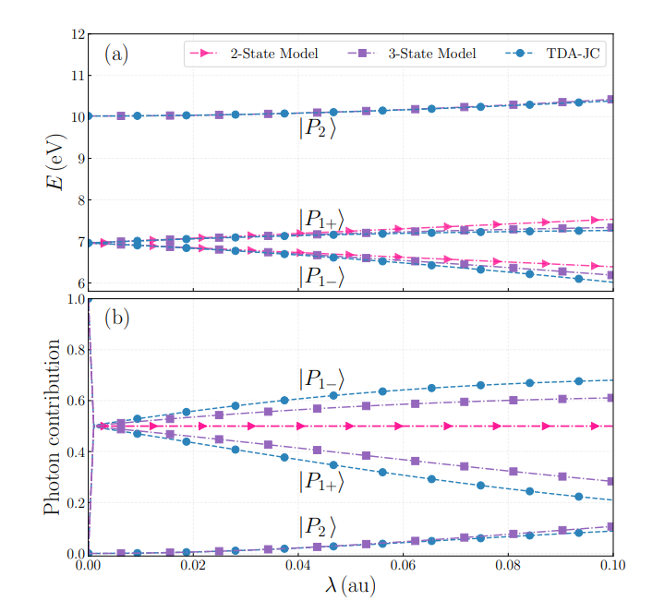
Application of QED-TD-DFT to polaritonic systems
Computationally similar timescales as TD-DFT – Very feasible to do
Can be used to simulate the polaritonic properties of small molecules very well, both qualitatively and quantitatively
Challenge: How well does QED-TD-DFT model larger, more relevant fluorophores used in standard polaritonic experiments?
Yang, J., et al. Chem. Phys. 155 (6), 064107 (2021). https://doi.org/10.1063/5.0057542

Slide 8
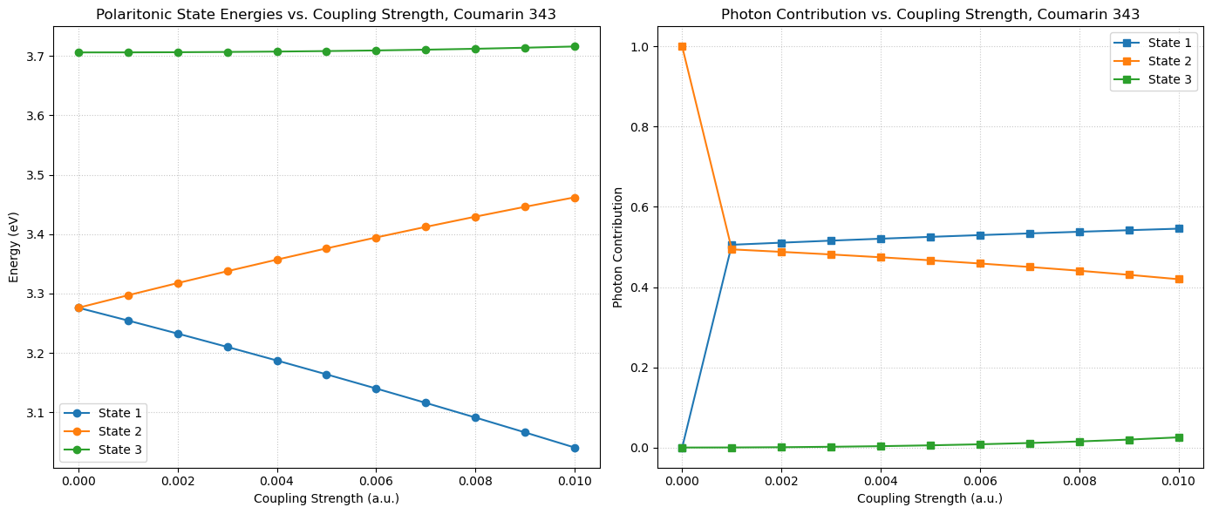
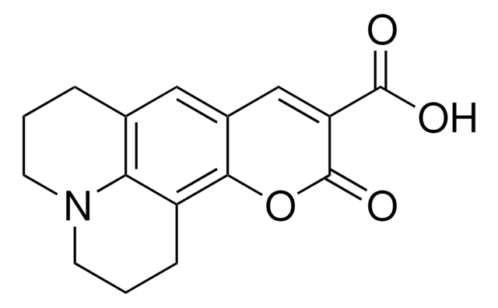
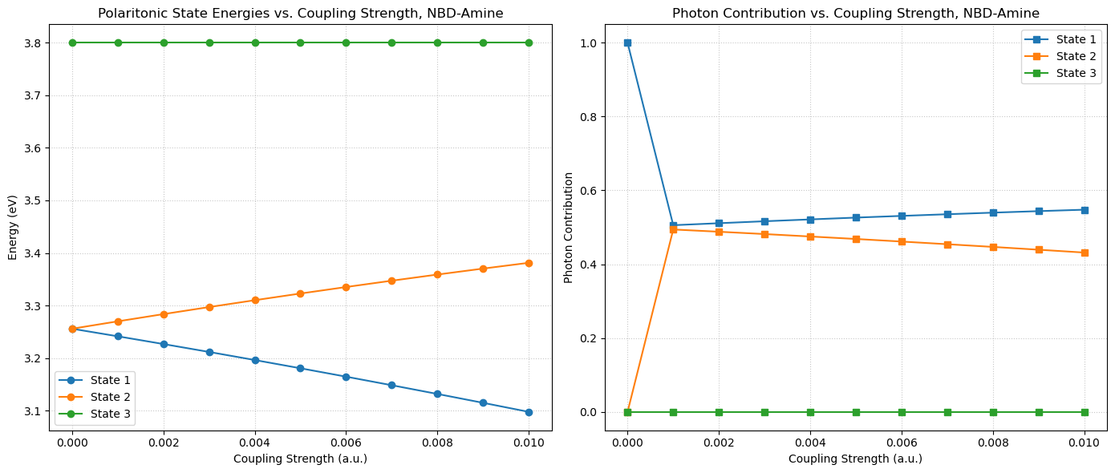
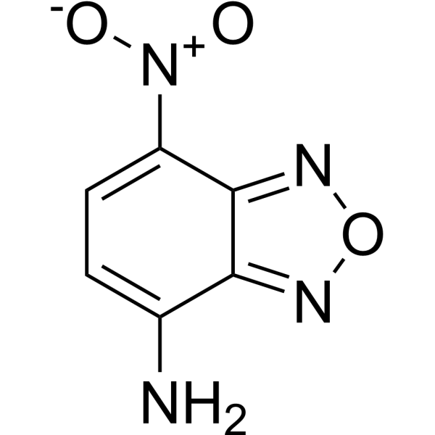
Polaritonic splitting vs. coupling strength λ
Workflow:
Ground state geometry optimization (B3LYP/cc-pVDZ)
Single-point DFT calculation (B3LYP/6-31+G**) with ddCOSMO PMMA simulation
Standard TDA calculation to find first transition frequency, with ddCOSMO
TDA-JC with ddCOSMO
Coumarin 343
NBD-Amine

Slide 9
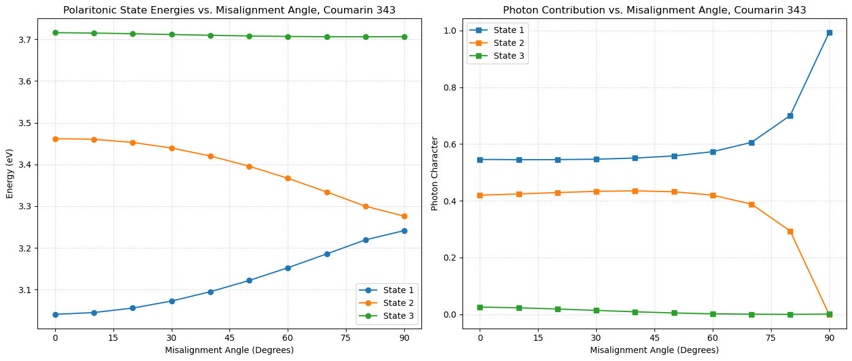
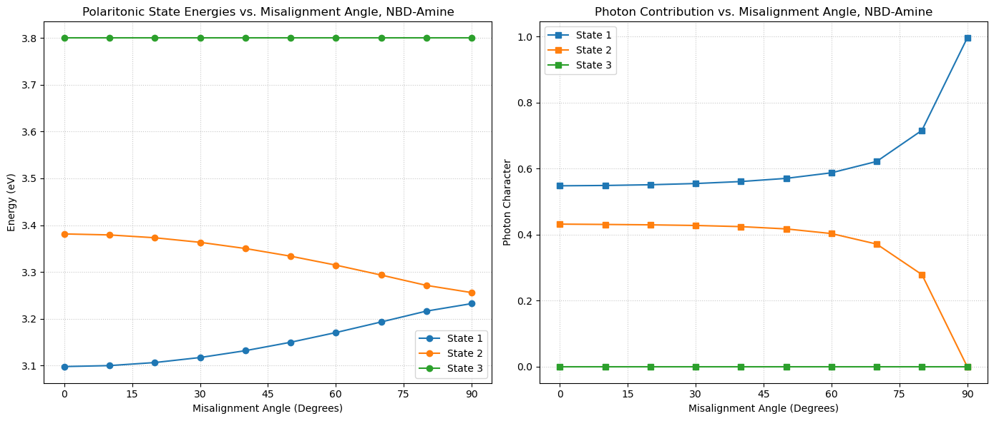
Polaritonic splitting vs. polarization vector alignment
Coumarin 343
NBD-Amine

Slide 10
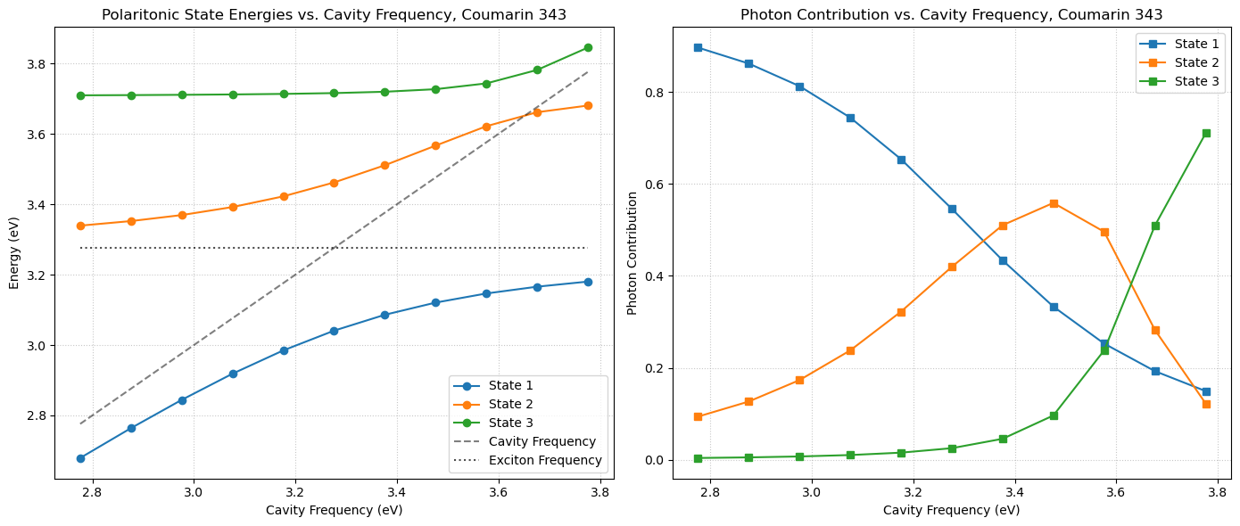
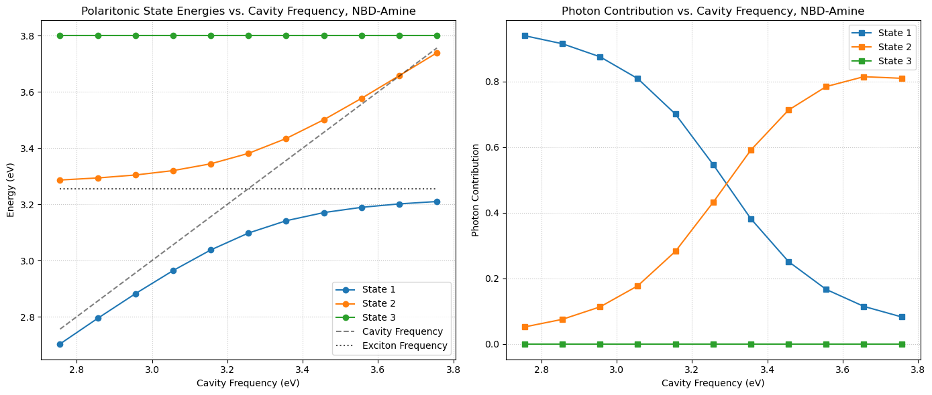
Polaritonic splitting vs. cavity frequency
Avoided crossing diagrams!
Coumarin-343 shows interactions of the next polariton too – basic two-state splitting model can’t qualitatively show this at all
Coumarin 343
NBD-Amine

Slide 11
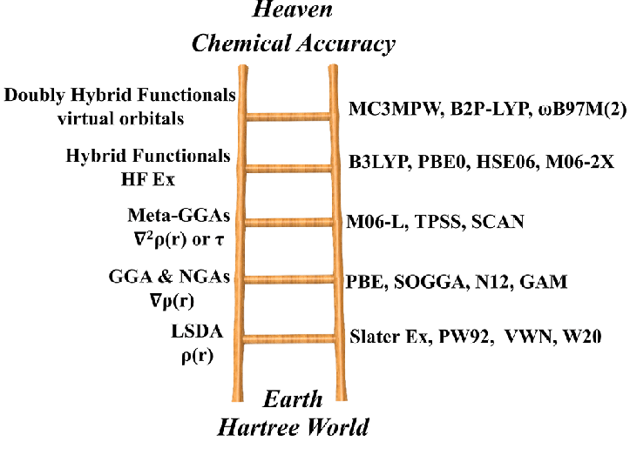
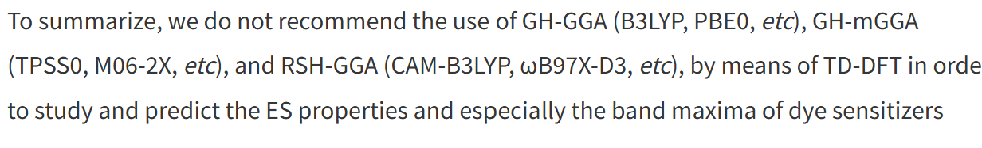
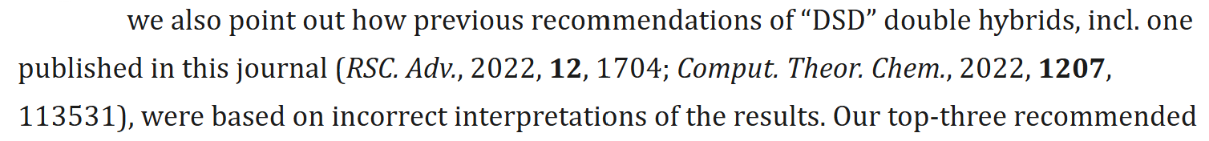
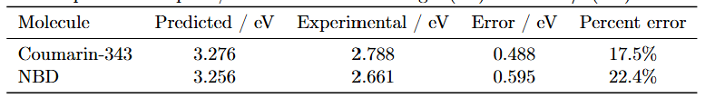
Issues with quantitative conclusions from TDA-JC on Coumarin 343 and NBD
- Lee et al. (K. Birgitta Whaley Group), on Coumarin (2013)
- Alkhatib et al., on other dye BODIPY (2022), advocating DSD functionals
- Sebastian et al., also on BODIPY (2025), denouncing DSD functionals
“For wide is the conjugated molecule and long-range is the correlation that leads to destruction, and many continue to calculate it.” – Matthew 7:13
Choice of basis, functional, QED-TD-DFT approximation, density fitting (and basis), and solvent effect modelling matter!

Slide 12
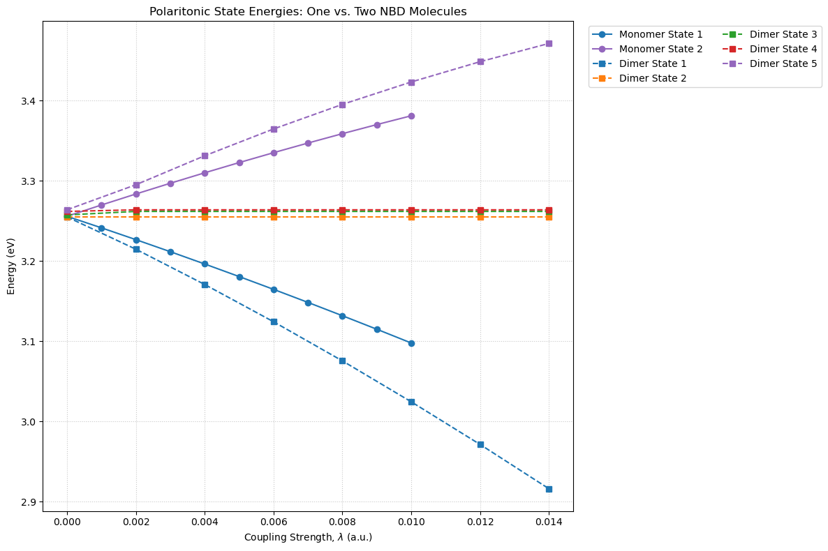
Extended applications of QED-TD-DFT
Polaritonic coupling of FRET pairs in a cavity (hybridization of donor, acceptor, and photon energy levels) (WIP)
Spectroscopic predictions on polaritonic systems, modelling dark states (see left)
Looking at vibrational strong coupling instead of electronic strong coupling with photons (cavity tuned to frequency of a molecular vibration)
Polaritonic chemistry and transition state calculations
QED-TD-DHDFT for double-hybrid functionals
Extension of theory to similar coupled systems, e.g. exciton-optical phonon coupling

Slide 13
Coupling Strength
Polarization Vector Alignment
Coumarin-343
NBD-Amine

